Slide 1

Air flight status detection
CS 777 Big Data Analytics

Slide 2

About Dataset
The dataset is an air flight status dataset and has been chosen from Kaggle. The dataset has 61 columns and a few million rows. The dataset contains all flight information including cancellation and delays by different airlines. The dataset was downloaded from Kaggle for the years 2018, 2019, 2020, 2021 & 2022.

Slide 3

Goals
Combine
Combine all the datasets for the years 2018, 2019, 2020, 2021 & 2022 into a single dataset.
Take
Take a sample from the combined dataset to create a small dataset on which the PySpark script can be run locally.
Perform
Perform data wrangling (data cleaning, feature engineering).
Perform
Perform visualizations to get a good understanding of the dataset.
Perform
Perform statistical analysis on the dataset.
Perform
Perform feature selection on the dataset.
Perform
Perform Machine Learning techniques to predict delay status of the flights.

Slide 4

Data cleaning
The columns that were redundant or did not add any value to predicting the delay status were removed.
Removed the flights which had been cancelled and then removed the ‘Cancelled’ column.
Removed all rows having null values in them.

Slide 5

Data transformation
Created a target variable ‘Delay_Status’. All the flights which had delayed arrival and departure times were considered as having been delayed and the rest were not delayed. This variable was made using the data from 'DepDelay' and 'ArrDelay' columns. Therefore, after creating the ‘Delay_Status’ column, these two columns were removed.
The columns ‘OriginCityName’ and ‘DestCityName’ were split into two, one having the city name and the other having the name of the state in which the city was located.
The columns ‘ArrTime’ and ‘DepTime’ were converted to date time format and then split into hours and minutes column. Subsequently, the ‘ArrTime’ and ‘DepTime’ columns were then removed.

Slide 6

Data Visualization

Slide 7
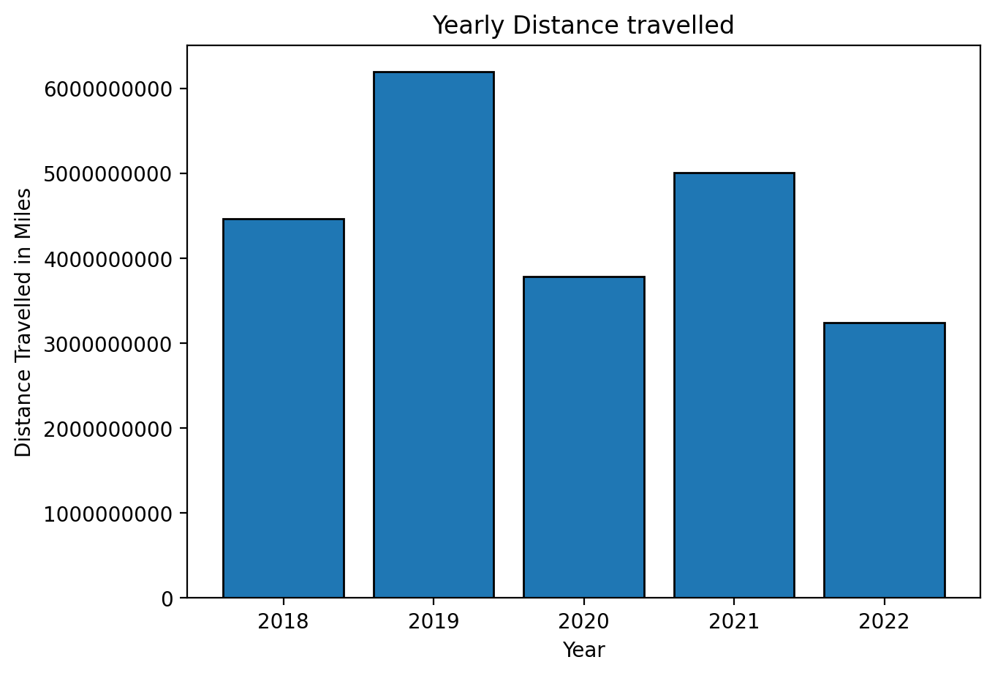
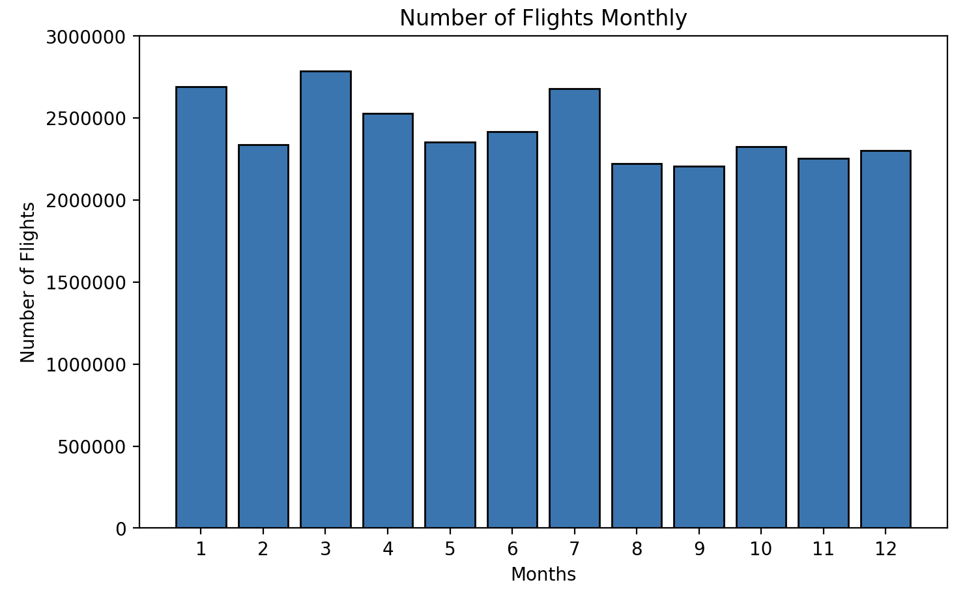
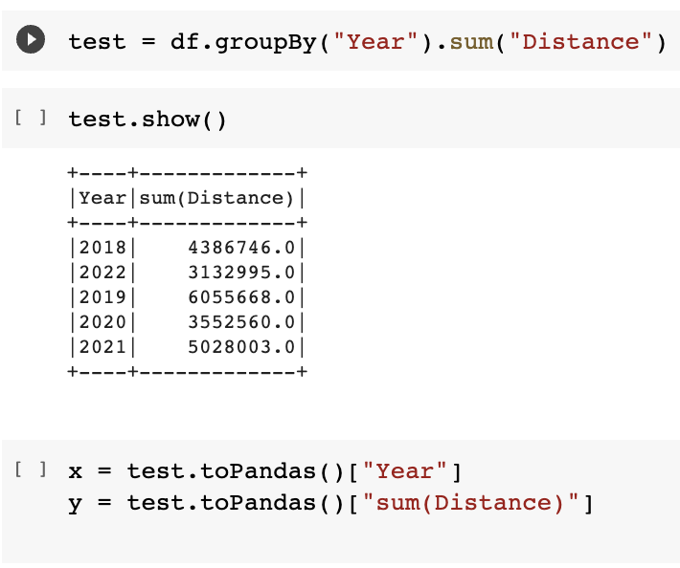
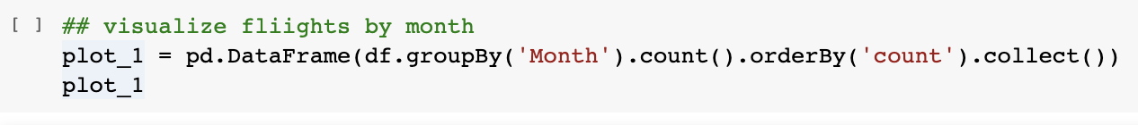
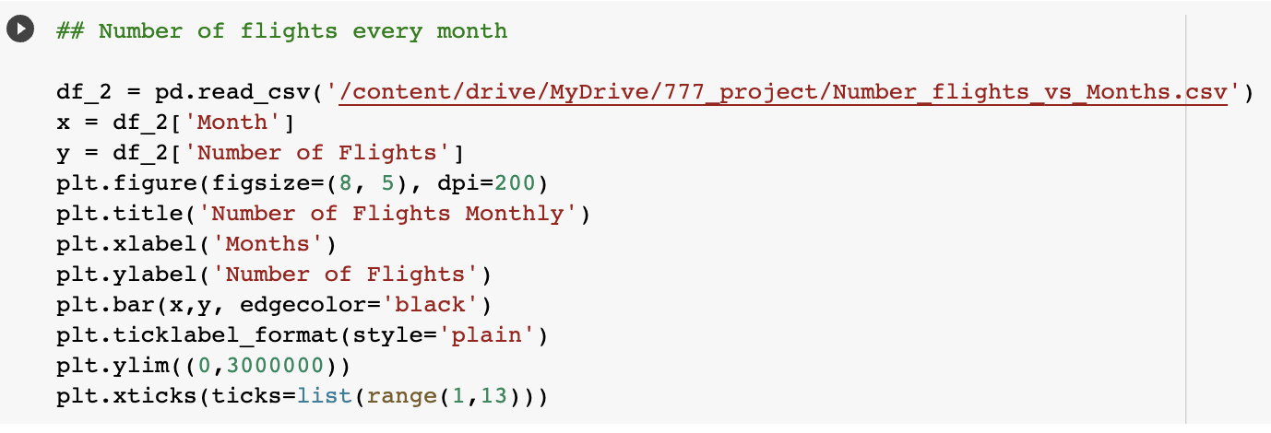

Slide 8
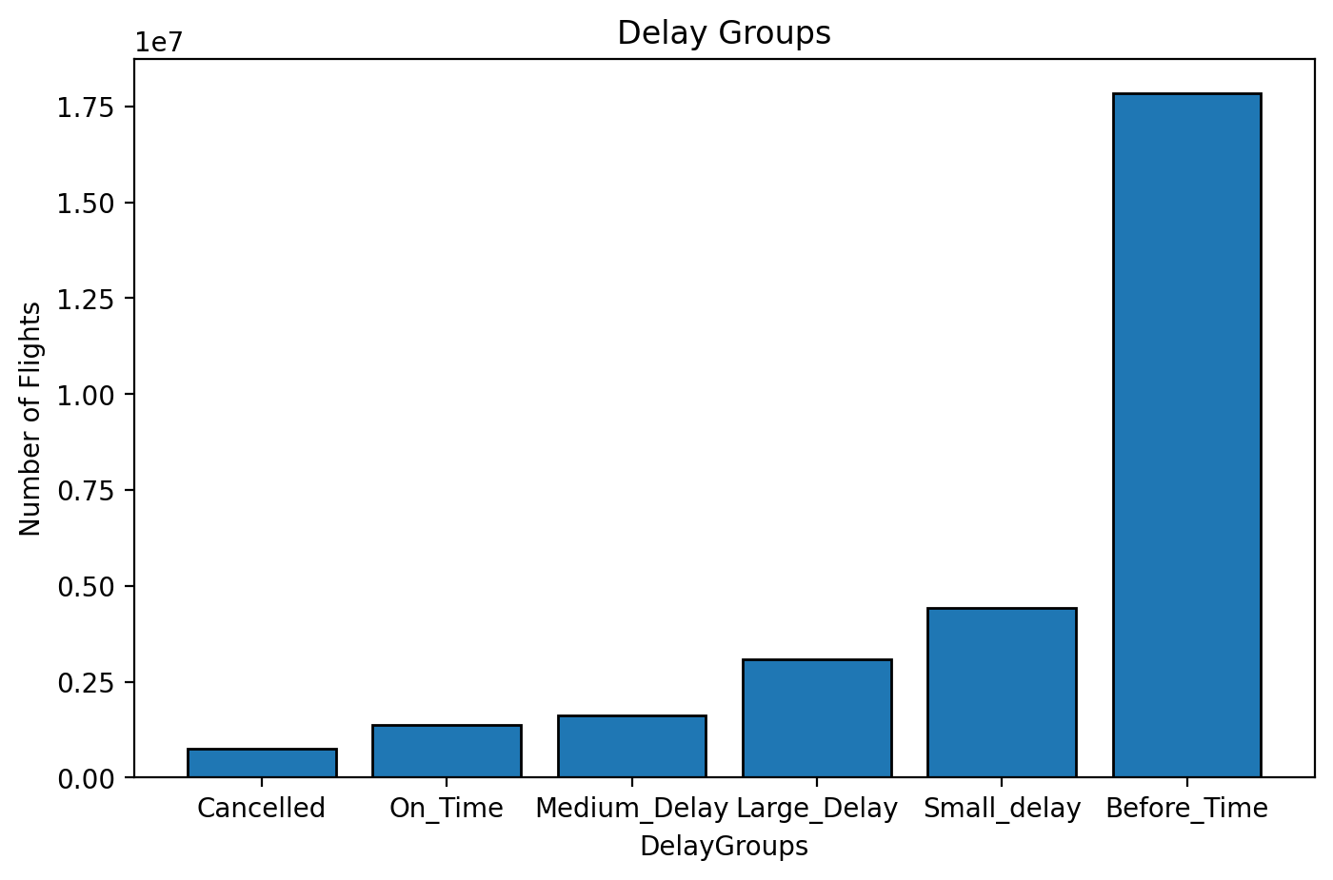
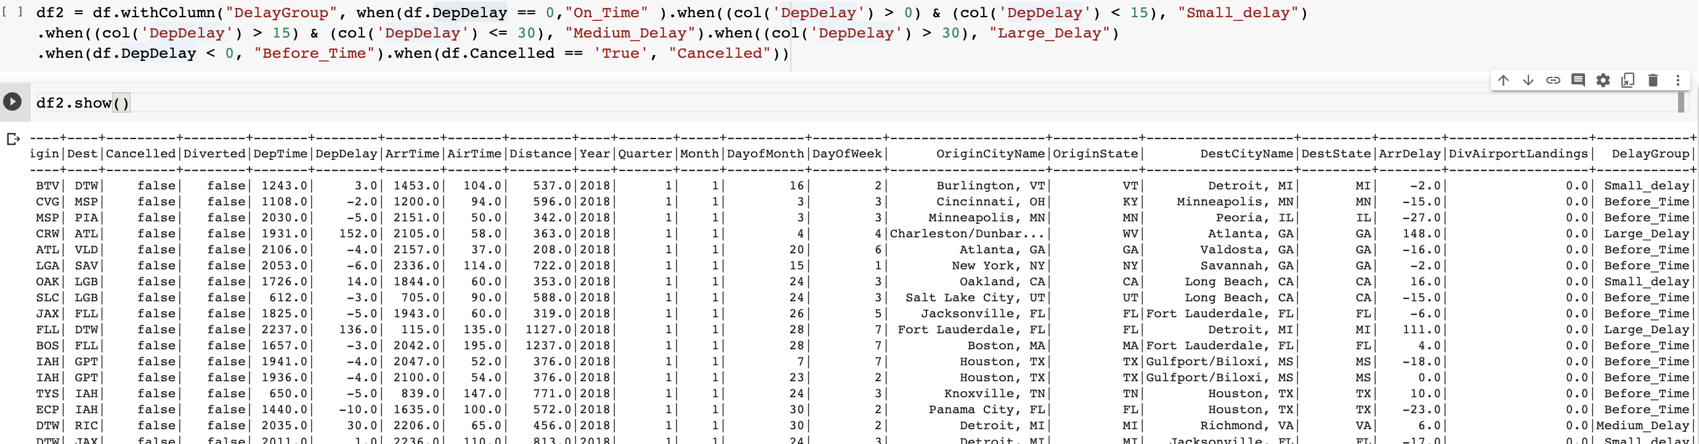
To help better understand the dataset, we have created a new column ‘DelayGroup’ from distributing the values of ‘DepDelay’ column as shown below.

Slide 9
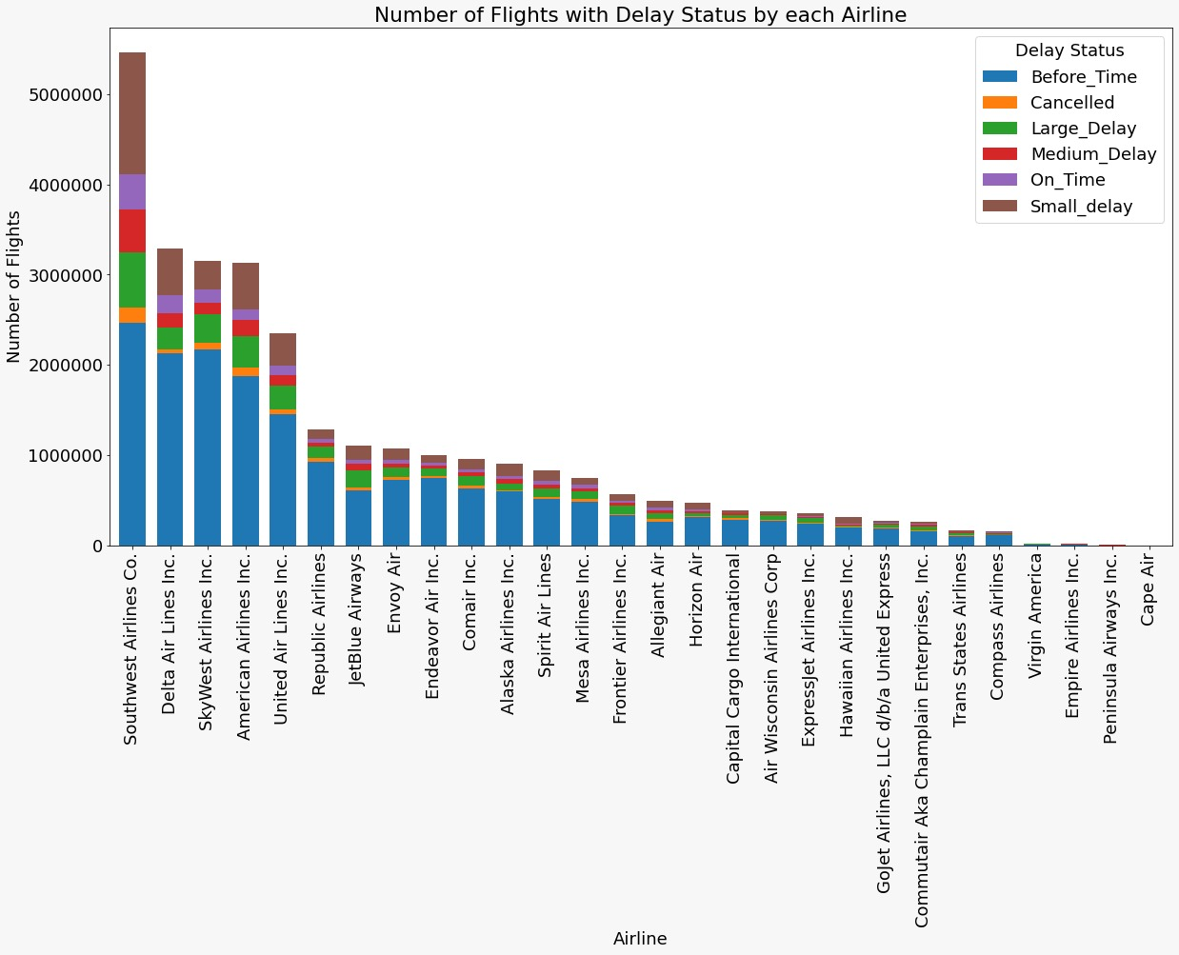

Slide 10

Statistical Analysis

Slide 11
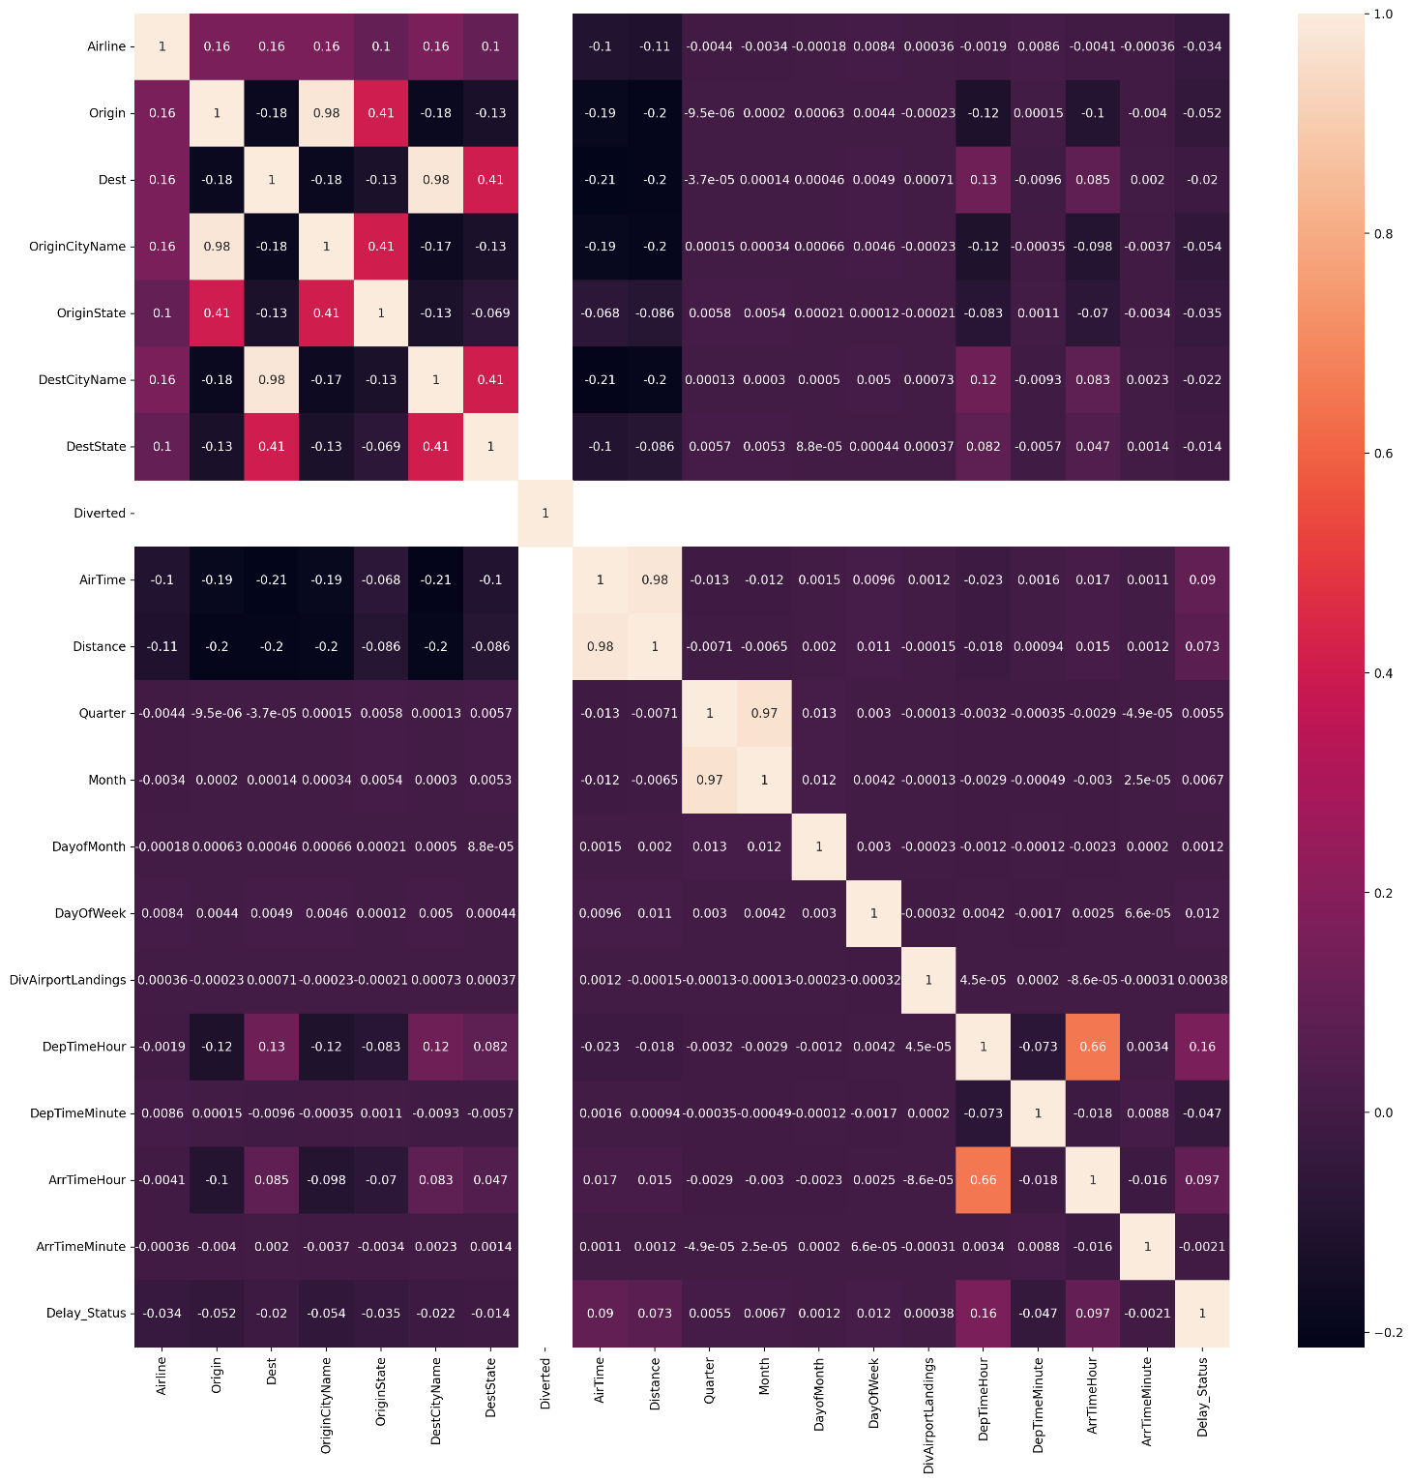

Slide 12
Hypothesis Testing(Chi Squared Test)
In this we will be testing whether a feature is independent or dependent with respect to the target variable. This test will be done only on categorical variables.
Since the P-value is near to 0, we reject the
Null hypothesis.
features | pValue | degreesOfFreedom | statistics
Airline | 0 | 27 | 447560.449
OriginCityName | 0 | 370 | 274566.1791
OriginState | 0 | 52 | 160846.3607
DestCityName | 0 | 370 | 191978.2396
DestState | 0 | 52 | 129005.1561

Slide 13
Feature Selection
We have used 2 feature selection methods:
Univariate feature selection: Univariate feature selection examines each feature individually to determine the strength of the relationship of the feature with the response variable.
Variance threshold feature selection: Features with low variance are less likely to be useful than features with high variance. We first calculate the variance of each feature then drop all features whose variance is below the threshold.

Slide 14
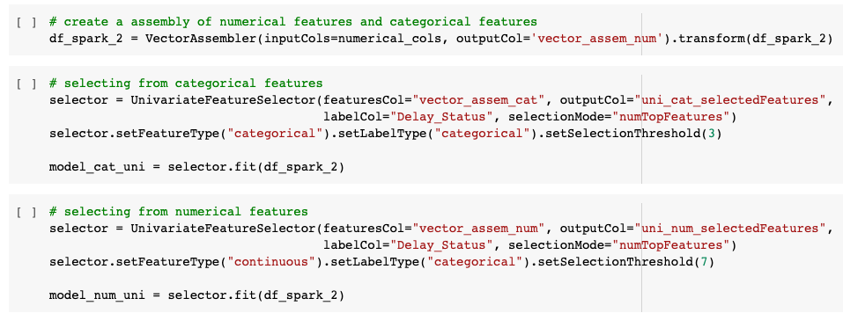
Univariate Feature Selection
ANOVA for numerical features and chi squared for categorical variables
Steps:
Create a vector assembler
Applying feature selection on categorical columns
Applying feature selection on numerical columns
Numerical selected features
AirTime
Month
DayOfWeek
DepTimeHour
DepTimeMinute
ArrTimeHour
ArrTimeMinute
Categorical selected features
Airline
OriginCityName
OriginState

Slide 15
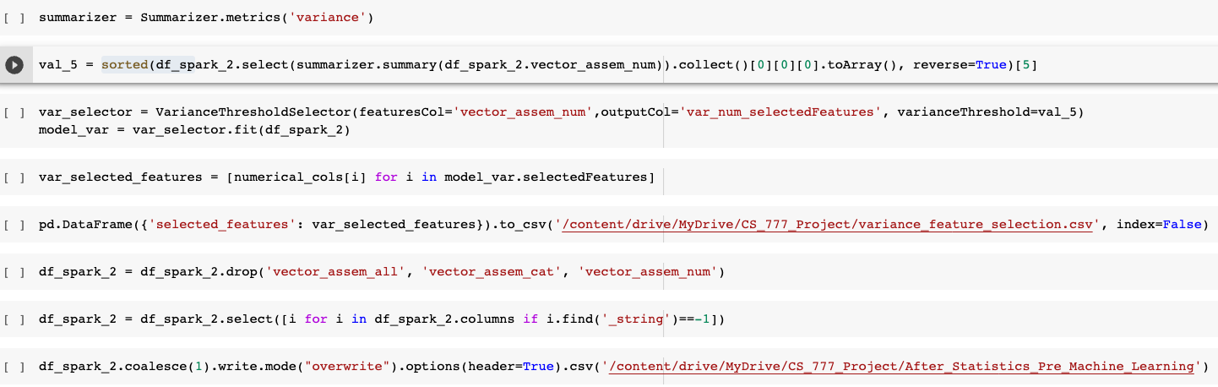
Variance Threshold Selection
Steps involved:
Sorting columns based on variance
Applying feature selection on only numerical columns
Numerical selected features
AirTime
DayOfMonth
DepTimeHour
DepTimeMinute
ArrTimeHour
ArrTimeMinute

Slide 16

Machine Learning Models Application

Slide 17

Pipeline stages
String indexing the categorical variables
One hot encoding the categorical variables
Scaling the numerical variables
Creating a vector of all the features
Using different machine learning techniques

Slide 18
Logistic Regression
Regularization parameter: 0.1, 0.01, 0.05
Elastic net parameter: 0.0, 0.5, 1.0
Dataset | Regularization | Elastic Net | ROC Area | Accuracy | True Positive Rate | False Positive Rate | Precision | F1 Score
Full Data | 0.01 | 0 | 0.66 | 0.59 | 0.89 | 0.73 | 0.57 | 0.55
Univariate Selection Data | 0.01 | 0 | 0.65 | 0.59 | 0.89 | 0.74 | 0.57 | 0.54
Variance Selection Data | 0.01 | 0 | 0.65 | 0.60 | 0.88 | 0.71 | 0.57 | 0.56

Slide 19
Logistic Regression
Dataset | ROC Area | Accuracy | True Positive Rate | False Positive Rate | Precision | F1 Score
Full Data | 0.66 | 0.60 | 0.89 | 0.72 | 0.57 | 0.55
Univariate Selection Data | 0.65 | 0.59 | 0.89 | 0.73 | 0.57 | 0.55
Variance Selection Data | 0.65 | 0.60 | 0.87 | 0.70 | 0.57 | 0.56

Slide 20
Logistic Regression with cross validation
Dataset | Regularization | Elastic Net | ROC Area | Accuracy | True Positive Rate | False Positive Rate | Precision | F1 Score
Full Data | 0.01 | 0 | 0.66 | 0.59 | 0.89 | 0.73 | 0.57 | 0.55
Univariate Selection Data | 0.01 | 0 | 0.65 | 0.59 | 0.89 | 0.74 | 0.57 | 0.54
Variance Selection Data | 0.01 | 0 | 0.65 | 0.60 | 0.88 | 0.71 | 0.57 | 0.56

Slide 21
Decision Tree
Maximum depth of tree: 5, 10, 15, 20
Number of trees: 5, 10, 15, 20
Impurity: Gini, Entropy
Dataset | Impurity | Max Depth | ROC Area | Accuracy | True Positive Rate | False Positive Rate | Precision | F1 Score
Full Data | gini | 5 | 0.51 | 0.58 | 0.94 | 0.79 | 0.56 | 0.52
Univariate Selection Data | gini | 5 | 0.51 | 0.58 | 0.94 | 0.79 | 0.56 | 0.52
Variance Selection Data | entropy | 20 | 0.51 | 0.63 | 0.84 | 0.59 | 0.60 | 0.61
Gini is calculated by using; 𝐺𝑖𝑛𝑖𝐼𝑛𝑑𝑒𝑥=1–∑𝑗𝑝2𝑗 (Max value of Gini can be 0.5 and min value can be 0)
Entropy can be calculated by using; 𝐸𝑛𝑡𝑟𝑜𝑝𝑦=–∑𝑗𝑝𝑗⋅𝑙𝑜𝑔2⋅𝑝𝑗 (Min: 0 & Max: 1)

Slide 22
Linear Support Vector Machine
Regularization parameter: 0.0, 0.3, 0.5, 1.0, 2.0
Dataset | Regularization | ROC Area | Accuracy | True Positive Rate | False Positive Rate | Precision | F1 Score
Full Data | 2.00 | 0.65 | 0.52 | 1.00 | 1.00 | 0.52 | 0.35
Univariate Selection Data | 1.00 | 0.64 | 0.52 | 1.00 | 1.00 | 0.52 | 0.35
Variance Selection Data | 0.50 | 0.64 | 0.52 | 1.00 | 1.00 | 0.52 | 0.35

Slide 23
Naïve Bayes
Smoothing parameter: 0.0, 0.3, 0.5, 0.7, 1.0
Dataset | Smoothing | ROC Area | Accuracy | True Positive Rate | False Positive Rate | Precision | F1 Score
Full Data | 0.70 | 0.55 | 0.52 | 0.21 | 0.14 | 0.61 | 0.47
Univariate Selection Data | 0.30 | 0.54 | 0.52 | 0.17 | 0.12 | 0.61 | 0.45
Variance Selection Data | 1.00 | 0.55 | 0.52 | 0.20 | 0.13 | 0.62 | 0.46

Slide 24
Gradient Boosted Trees
Maximum depth of tree: 5, 10, 15, 20
Dataset | Max Depth | ROC Area | Accuracy | True Positive Rate | False Positive Rate | Precision | F1 Score
Full Data | 20.00 | 0.72 | 0.65 | 0.82 | 0.53 | 0.62 | 0.64
Univariate Selection Data | 20.00 | 0.72 | 0.65 | 0.81 | 0.52 | 0.63 | 0.64
Variance Selection Data | 20.00 | 0.74 | 0.67 | 0.82 | 0.50 | 0.64 | 0.66

Slide 25
Random Forest
Impurity method: 'gini', 'entropy'
Maximum depth of tree: 5, 10, 15, 20
Number of trees: 5, 10, 15, 20
Dataset | Impurity | Max Depth | Trees | ROC Area | Accuracy | True Positive Rate | False Positive Rate | Precision | F1 Score
Full Data | entropy | 20 | 20 | 0.68 | 0.57 | 0.98 | 0.87 | 0.54 | 0.47
Univariate Selection Data | entropy | 20 | 20 | 0.68 | 0.58 | 0.96 | 0.83 | 0.55 | 0.50
Variance Selection Data | gini | 20 | 20 | 0.67 | 0.58 | 0.97 | 0.86 | 0.55 | 0.47

Slide 26

Thank you for attention! Any questions?

